Slide 1
8. Practical Considerations
8.1 AI workflow
8.2 Preparing data
8.3 Time series transformations
8.4 Selection of inputs
8.5 Data encoding
8.6 Dimensionality reduction
8.7 Generalization
8.8 Improving generalization
8.9 General guidelines
8.10 Deployment

Slide 2

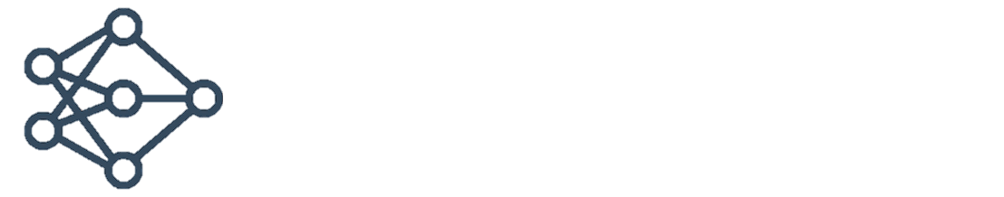







8.1 AI workflow
Prepare Data
Train Model
Deploy System
Data access and preprocessing
Model design,
Hyperparameter tuning
Multiplatform code generation (CPU, GPU)
Ground truth labeling
Model exchange across frameworks
Edge deployment
Simulation-based data generation
Hardware-accelerated training
Enterprise Deployment
I Iteration and Refinement

Slide 3
8.2 Preparing data
Neural network could, in principle, map raw input data into required outputs → in practice, this will generally give poor results
For most applications, some data manipulations are recommended:
Preparing data
Designing the training data
Handling missing and extreme data
Incorporating invariances and prior knowledge
Preparing inputs (also referred to as features)
Pre-processing, rescaling, normalizing, standardizing, detrending
Dimensionality reduction: principal component analysis
Feature selection, feature extraction
Preparing outputs (also referred to as responses)
Encoding of classes, rescaling, standardizing, post-processing

Slide 4
Designing the training data
Good training data are required to train a NN
Neural nets are not good at extrapolation
Training data must be representative of the problem considered
For pattern recognition
Every class must be represented
Within each class, statistical variation must be adequately represented
Potato chips factory example:
NN must be trained on 1) normal chips, 2) burned chips, 3) uncooked chips, ...
Large training set prevents overfitting
Overfitting = perfect fit to a small number of training data
Three-layer feedforward network example:
With 25 inputs and 10 hidden neurons → over 260 free parameters
Apply at least 500-1000 training samples (preferably more) for proper training

Slide 5
Missing data and outliers
Missing data
Disregard if not many data are missing
Substitute with
Mean value/s
Previous sample/s
Fixed number/s
Outliers
Can appear due to
Natural variation of the variable's distribution
Noise in the data acquisition chain
Defects
Carefull examination of the experiment is required to confirm the validity of outliers
If outliers have some significance, keep them in the training data
Some abnormality is normal!
Do not reject a point unless it is really wild

Slide 6
Data preprocessing
Some data transformations are usually necessary to achieve good neural network results
Rescaling
Add/subtract a constant and then multiply/divide by a constant
Example: convert a temperature from Celsius to Fahrenheit
Standardizing
Subtracting a measure of location and dividing by a measure of scale
Example: subtracting a mean and dividing by standard deviation, thereby obtaining a "standard normal" random variable with mean 0 and standard deviation 1
Normalizing
Dividing a vector by its norm
Example: make the Euclidean length of the vector equal to one.
In the NN literature, "normalizing" often refers to rescaling into the [0,1] range
Which operations should be applied to data? It depends!

Slide 7
Rescaling
Rescaling inputs
Often recommended rescaling of inputs to interval [0,1] is a misconception, there is in fact no such requirement
Interval [0,1] is usually a bad choice, rescaling to [-1,1] interval is better
Standardizing inputs is better than rescaling
Rescaling outputs
For bounded activation functions (range [0,1] or [-1,1] ) the target values must lie within that range The alternative is to use an activation function suited to the distribution of the targets, for example linear activation function
It is essential to rescale the multidimensional targets so that their variability reflects their importance, or at least is not in inverse relation to their importance If the targets are of equal importance, they should typically be rescaled or standardized to the same range or the same standard deviation

Slide 8
Standardizing
Standardizing usually refers to transforming data into zero mean with a standard deviation of one
Statistics (mean, std) are computed from training data only, not from validation data
Validation data must be standardized using the statistics computed from training data
Standardizing inputs
Often very beneficial for MLP and RBFN networks
RBFN – inputs are combined via a distance function (Euclidean) therefore it is important to standardize them into a similar range
MLP – standardizing enables utilization of steep parts of transfer functions → faster learning and avoidance of saturation
Standardizing outputs
Typically more of a convenience for getting good initial weights than a necessity
Important for the equal relevance of targets
Note: use rescaling for bounded activation functions, not standardizing!

Slide 9
8.3 Time series transformations
Detrending
Removing linear trend from the time series
After neural network application, the original trend is added to the results Careful: it is too easy to create a trend where none belongs!
Removing seasonal components
Yearly, monthly, weekly, daily, and hourly cycles can be removed before the application of neural networks
Decomposition methods
Differencing
Working with differences between successive samples can sometimes bring good results
For example, daily stock-market values convey one sort of information, the change from one day to the next conveys entirely different information
Differencing can be applied to inputs and outputs, a powerful option is to apply raw and diferrenced inputs!

Slide 10
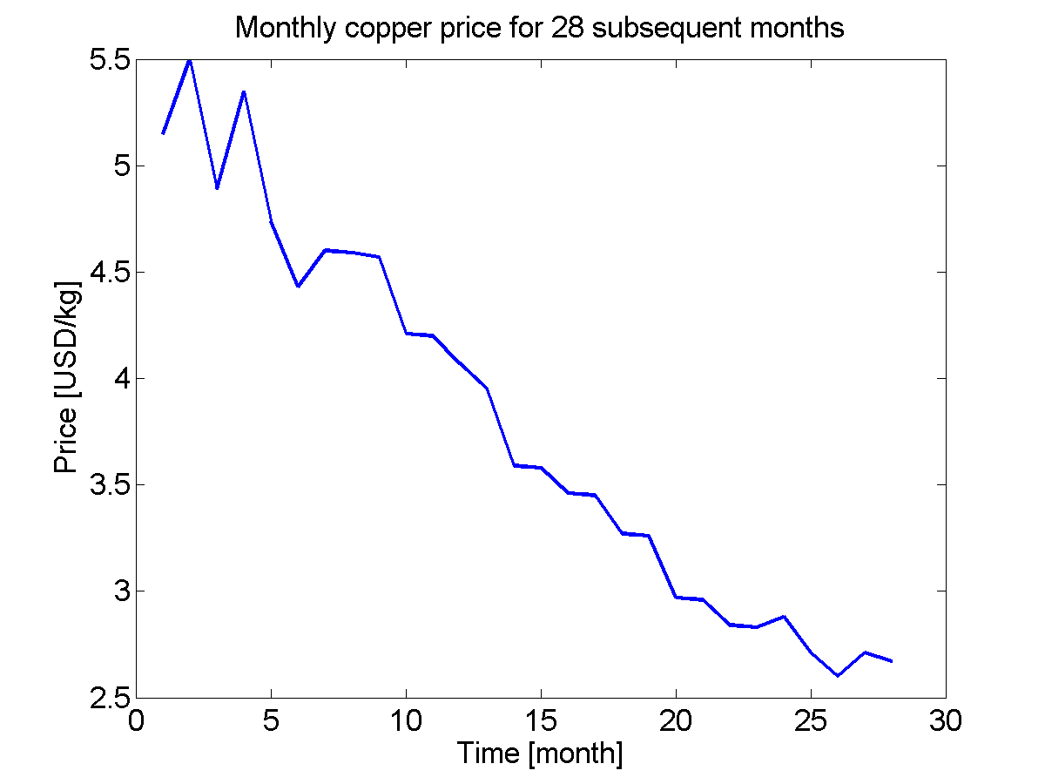
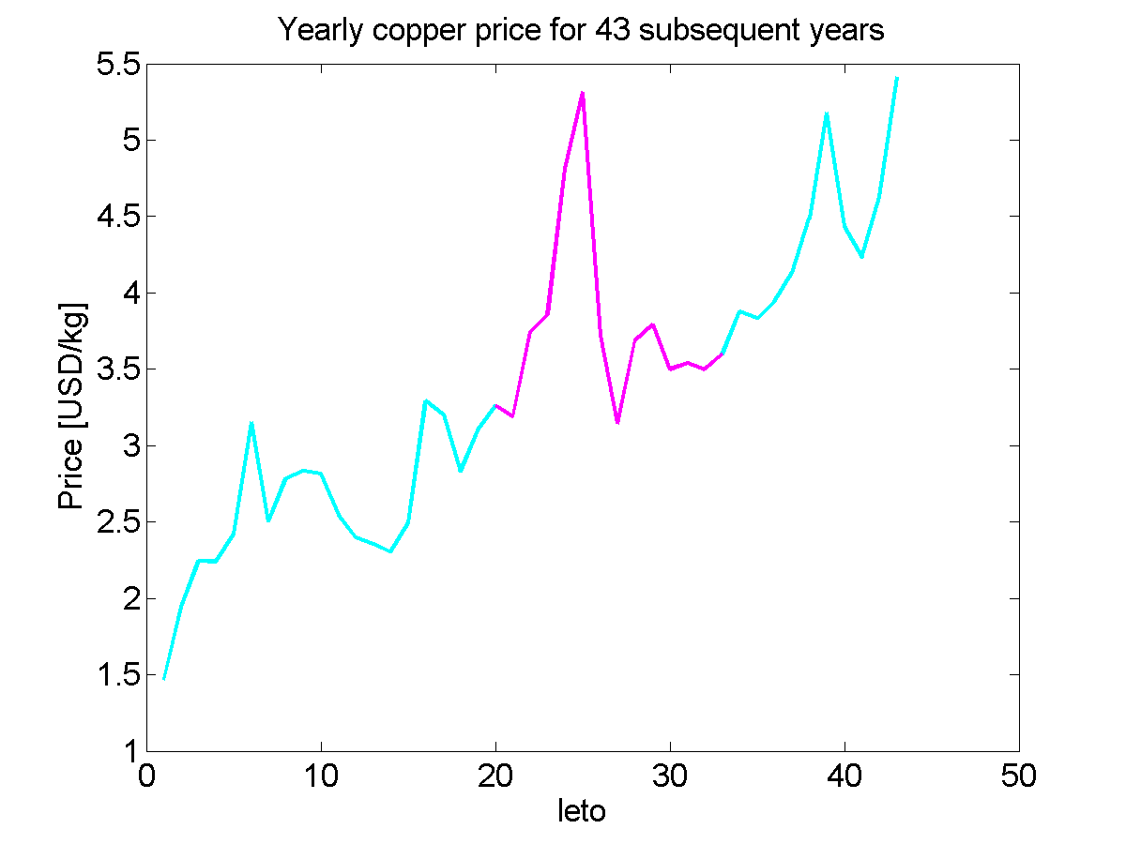
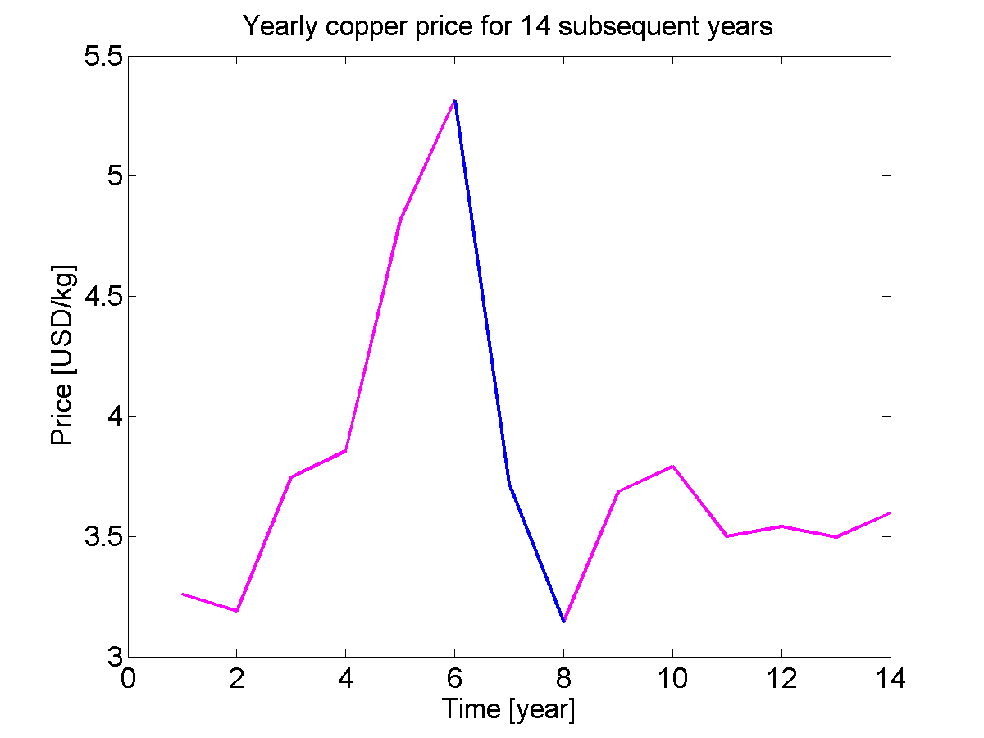
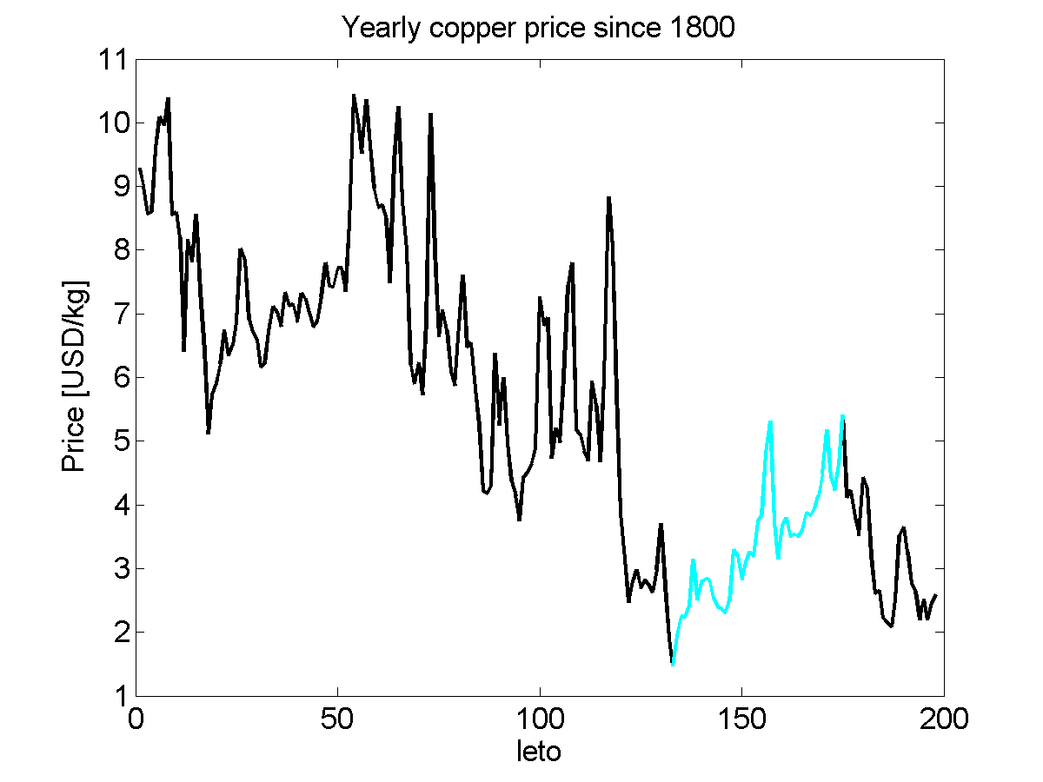
Why detrending is dangerous?

Slide 11
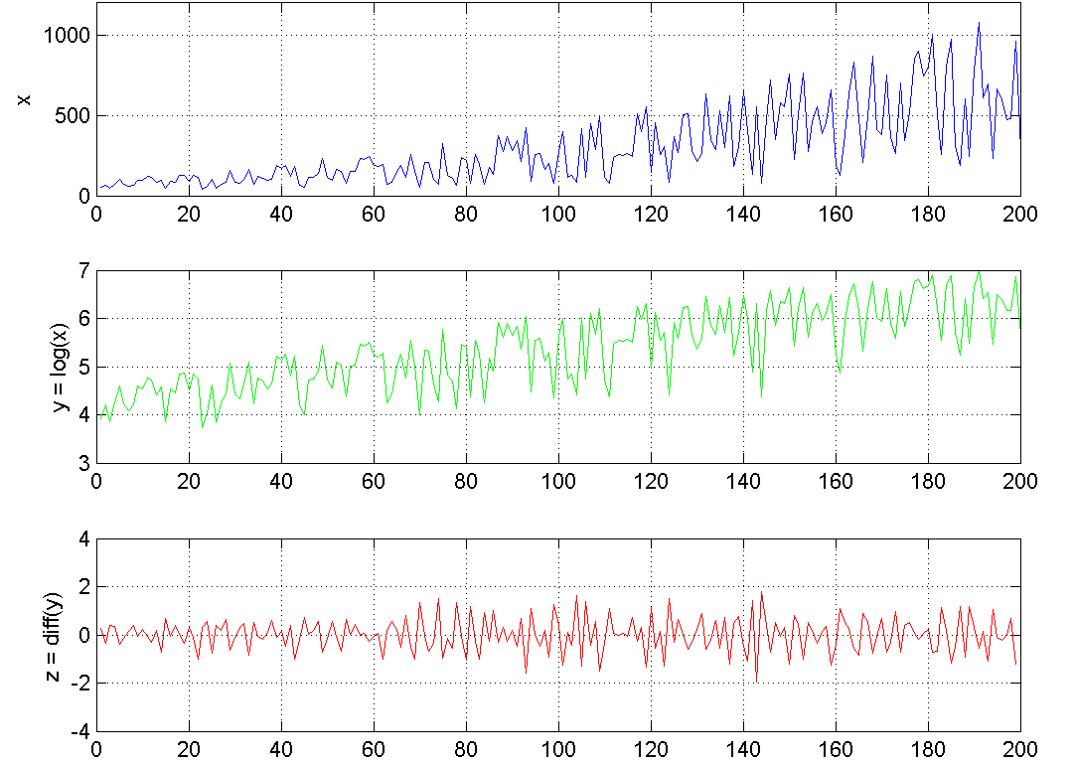
Example of time series preparation
Original data x
nonstationary mean
nonstationary variance
Log(x)
stationary variance
Differencing
stationary mean
stationary variance

Slide 12
Time series decomposition
Time series can often be decomposed into components
Trend (T)
Seasonal cycle (S)
Residual (E)
Decomposition can be additive or multiplicative
Additive: Y = T + S + E
Multiplicative: Y = T * S * E
Methods
X-12-ARIMA (U.S. Census Bureau, Statistical Research Divison )
STL (Seasonal Trend Decomposition based on Loess)

Slide 13
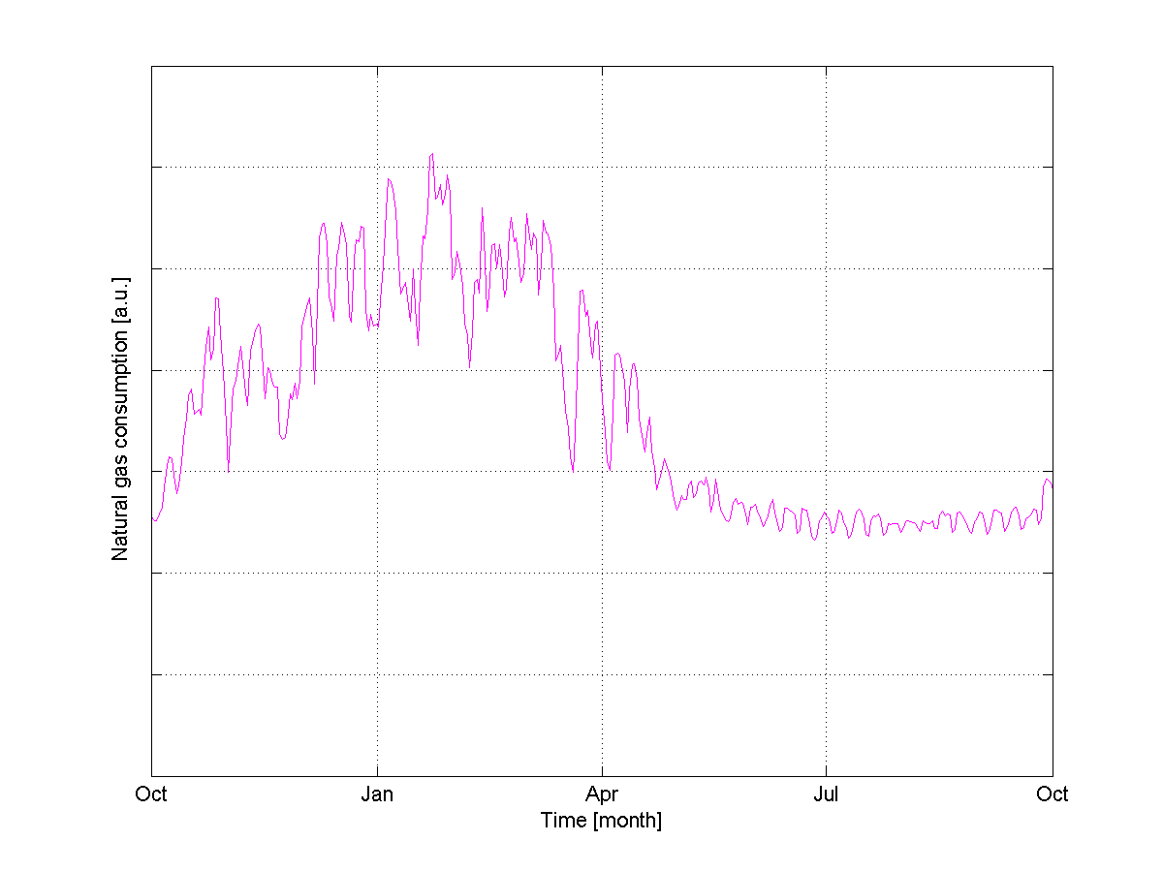
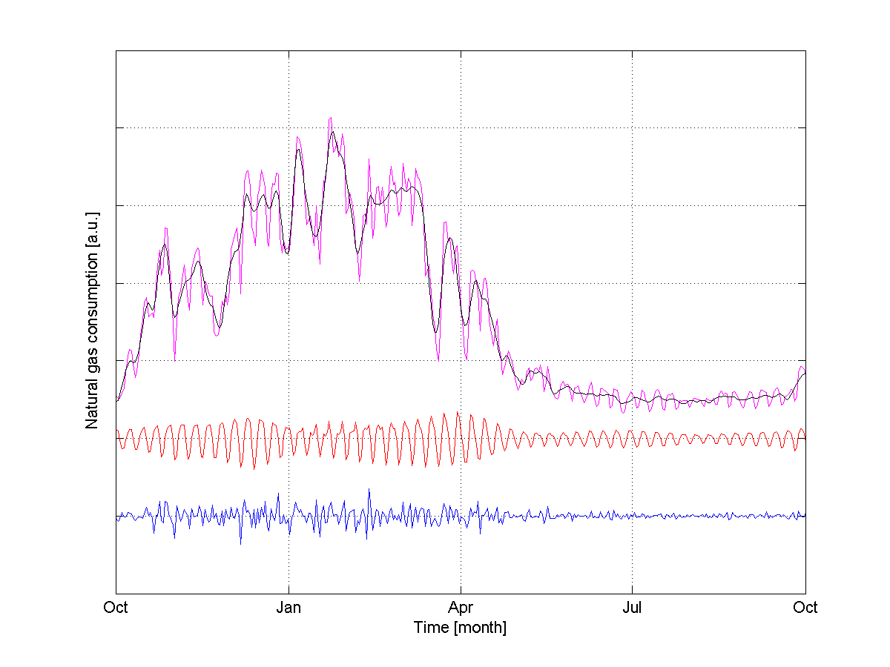
Example of STL decomposition
*STL = Seasonal and Trend decomposition using Loess
Daily energy consumption
Original data
Trend
Weekly cycle
Residual
Notes:
STL = Seasonal and Trend decomposition using Loess

Slide 14
8.4 Selection of inputs
Importance of inputs → which inputs should be selected for best results (classification or prediction) = feature selection
Several aspects of importance:
Predictive importance
Increase in generalization error when input is omitted from a network
Causal importance
How much do the outputs change if inputs are changed (also called sensitivity)
Marginal importance
Considers inputs in isolation
Easy to compute without even training a neural net ...
Pearson correlation, rank correlation, mutual information, ...
Marginal importance is of little practical use other than for a preliminary description of the data

Slide 15
Methods of input selection
Practical approach
Selection of inputs based on cross-validation
General framework
Select a subset of inputs
Train and validate the network based on the selected subset of inputs
Based on the validation result, decide upon further inclusion/rejection of inputs
Continue iterating until good results are obtained
Direct search methods
Exhaustive search
Forward selection
Backward elimination
Selection by genetic algorithms, ...
Pruning methods
Removing nonrelevant inputs during the neural network construction

Slide 16
8.5 Data encoding
Non-numeric data (e.g. binary data, categorical data) should be encoded
Numeric variables
No need for encoding → check the need for rescaling or standardizing
Ordinal variables
Discrete data with natural ordering (e.g. 'small', 'medium', 'big')
Ordinal variables can often be represented by a single variable
Small | 1 |
Medium | 2 |
Big | 3 |
Thermometer coding (using ‘dummy’ variables)
Small | 0 0 1 |
Medium | 0 1 1 |
Big | 1 1 1 |
Improved thermometer coding → faster learning
Small | -1 -1 1 |
Medium | -1 1 1 |
Big | 1 1 1 |

Slide 17
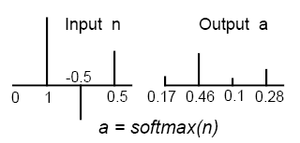

Data encoding
Categorical variables
Discrete data without ordering (e.g. 'apple', 'banana', 'orange' )
1-of-C coding
Red | 0 0 1 |
Green | 0 1 0 |
Blue | 1 0 0 |
1-of-(C-1) ... if the network has a bias
Red | 0 0 |
Green | 0 1 |
Blue | 1 0 |
1-of-C coding with a softmax activation function will produce valid posterior probability estimates
It is very important NOT to use a single variable for an unordered categorical target
Notes:
http://en.wikipedia.org/wiki/Softmax_activation_function

Slide 18
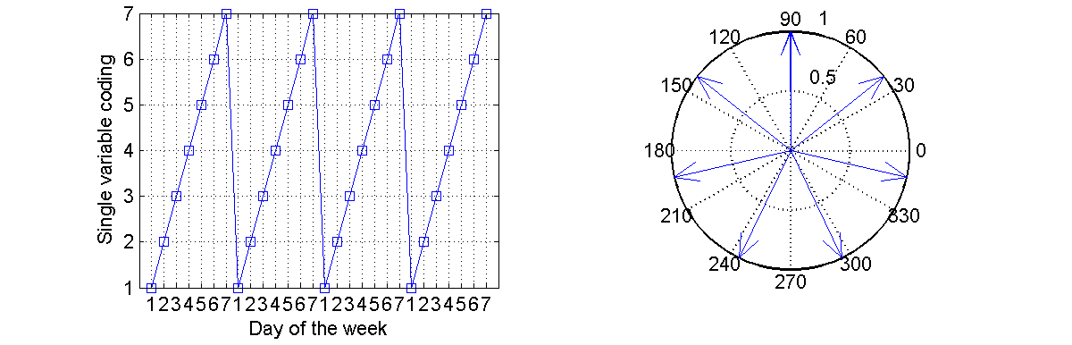
Data encoding
Circular discontinuity
How to encode variables that are fundamentally circular? ...
e.g. angle 0 … 360°
Day of the week (Mon=1, ..., Sun=7) → we have discontinuity when passing from 7 to 1, although Sunday and Monday are very close
Solutions
Discretizing and using any of the categorical coding (1-of-C)
Encoding with two dummy variables (sin, cos)
Tue
Wed
Mon
sin
cos
Thu
Sun
Fri
Sat

Slide 19
8.6 Dimensionality reduction
In some situations, dimension of the input vector is large, but the components of the vectors are highly correlated
It is useful in this situation to reduce the dimension of the input vectors → feature extraction
An effective procedure for performing this operation is principal component analysis (PCA)
PCA is a vector space transform used to reduce multidimensional data to lower dimensions for analysis
PCA method generates a new set of variables, called principal components
Also neural networks can be used for dimensionality reduction (autoencoder)

Slide 20
Principal Components Analysis
Input matrix X is represented as a linear combination of principal components z_{p}
Projection vectors α_{p} are eigenvectors of the covariance matrix XX^{T}
Each principal component z_{p} is obtained as a product of input matrix X with projection vectors α_{p}
Each principal component is a linear combination of original variables
All the principal components are orthogonal to each other, so there is no redundant information

Slide 21
PCA example
Original data: x₁, x₂
Principal components: z₁, z₂
Variability
z₁ → 95%
z₂ → 5%
Benefit
Dimensionality reduction by using only the first principal component (z₁) instead of original 2D data (x₁, x₂)

Slide 22
Properties of principal components
Principal components form an orthogonal basis for the data
1st principal component
The variance of this variable is the maximum among all possible choices of the first axis
2nd principal component
Is perpendicular to the 1st principal component. The variance of this variable is the maximum among all possible choices of this second axis.
Often, the first few principal components explain the majority of the total variance
These few new variables can be taken as low-dimensional input to the neural network instead of high-dimensional original data

Slide 23
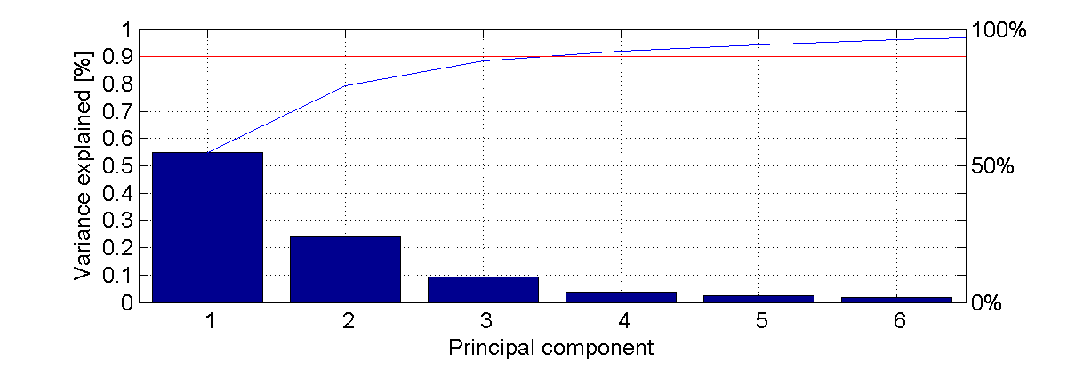
How to use PCA for neural networks
Load original data X
Compute principal components z
Plot variance explained
Decide how much variance to keep ... 90%, 95%?
Keep only a few selected principal components, discard the rest → data dimensionality is reduced

Slide 24
Intrinsic dimensionality
Suppose we apply PCA on d-dimensional data and discover that the first n-eigenvalues have significantly larger values (n < d)
Consequently, data can be represented with high accuracy by first n-eigenvalues → effective dimensionality is only n
Generally, data in d-dimensions have intrinsic dimensionality equal to n if data lies entirely within an n-dimensional subspace

Slide 25

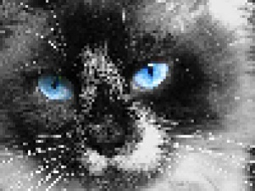
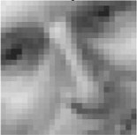
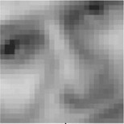
Neural nets for dimensionality reduction
Multilayer feedforward neural networks can be used to perform nonlinear dimensionality reduction
Auto-associative multilayer perceptron (autoencoder) with extra hidden layers can perform a general nonlinear dimensionality reduction
Number of neurons: 1024 300 50 300 1024
32 x 32 pixels
32 x 32 pixels
Nonlinear dimensionality reduction

Slide 26
Invariances and prior knowledge
In many practical situations we have, in addition to the data itself, also a priori knowledge
General information about the form of the mapping
Prior probabilities of class membership
Information about constraints
Knowledge about invariances
How to build invariances into neural networks?
Invariance by neural network structure
Shared weights, Higher-order neural networks
Invariance by training
Include a large number of translated inputs to train NN
Invariant feature space
Extract features that are invariant for the problem considered
Check also "Knowledge representation" in NN2a_Neuron_and_architectures

Slide 27
Handwritten character recognition problem
Recognize handwritten characters ‘a’ and ‘b’
Image representation
Grid of pixels (typically 256x256) → 65536 inputs
Gray level [0..1] (typically 8-bit coding)
Extraction of the features:
Solving two problems
Invariance problem (translations)
Curse of dimensionality problem

Slide 28
8.7 Generalization
The goal of network training is not to exactly fit the data but to build a statistical model that generates the data
Well trained network is able to generalize → to make good predictions on new inputs
Here it is assumed that the test data are drawn from the same population used to generate the training data
Neural network designed to generalize well will produce correct input-output mapping even if new inputs differ slightly from the samples used to train the network
Overfitting problem → neural net learns the complete training set but not the underlying function

Slide 29
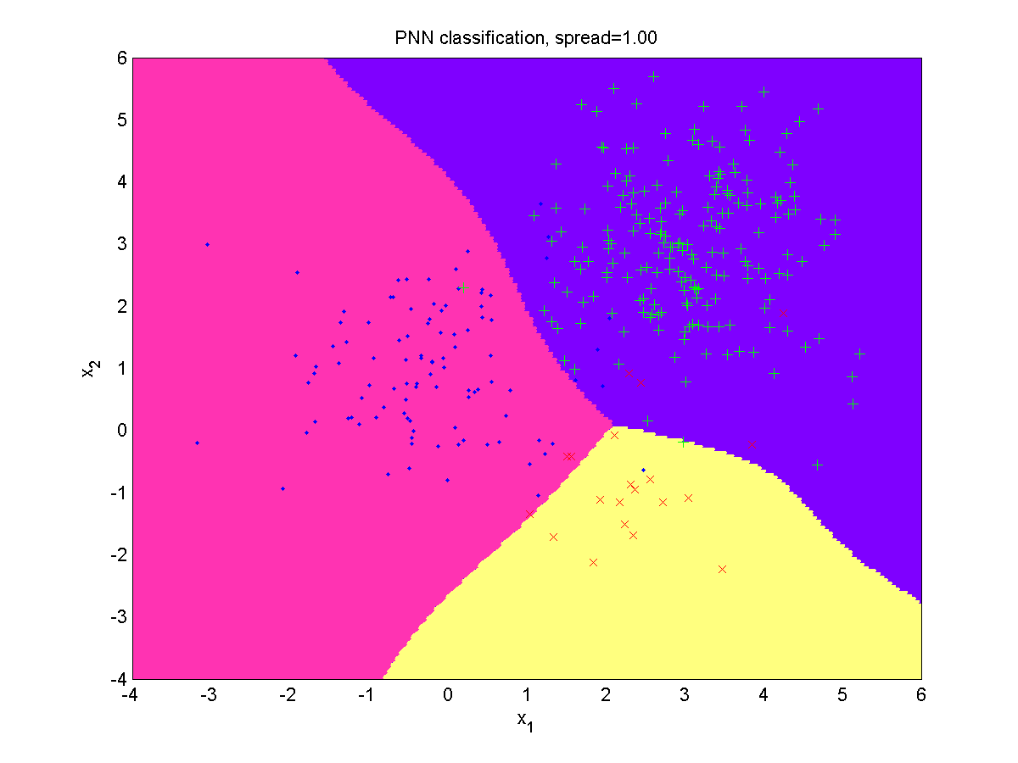
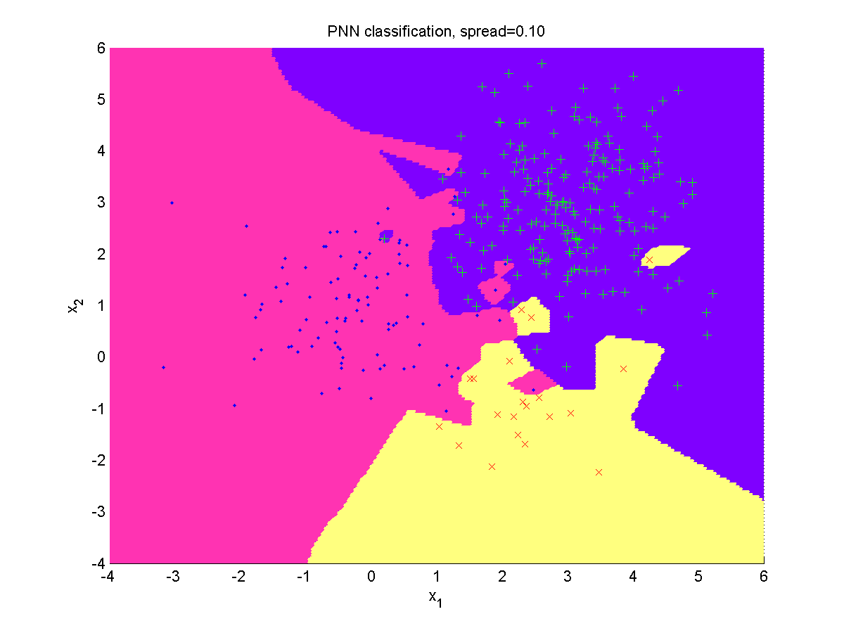
Generalization in classification
The task of our network is to learn a classification decision boundary
If we know that training data contains noise, we don’t necessarily want all the training data to be classified accurately, as that is likely to reduce the generalization ability
Good generalization
Overfitting

Slide 30
Generalization in function approximation
Function approximation based on noisy data samples
We can expect the neural network output to give a better representation of the underlying function if its output curve does not pass through all the data points
Again, allowing a larger error on the training data is likely to lead to better generalization
Good generalization
Overfitting

Slide 31
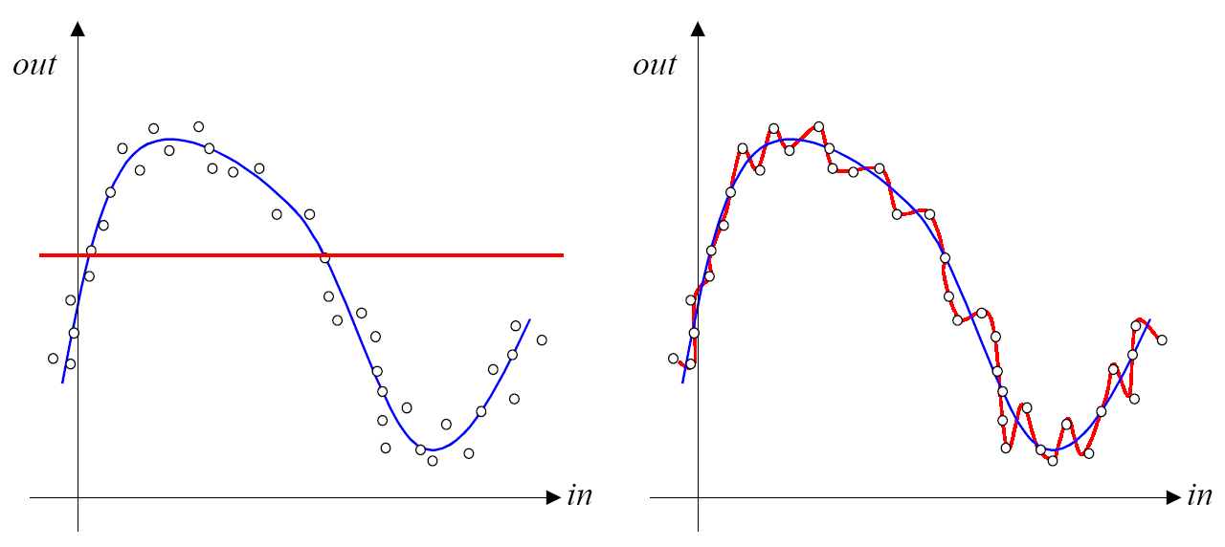
Underfitting, overfitting
Underfitting
Neural network is unable to properly learn the data due to an insufficient number of neurons or due to extreme regularization
Such a network also generalizes poorly
Overfitting
Neural network perfectly learns the training data but gives poor results on test data
Underfitting Overfitting

Slide 32
8.8 Improving generalization
How to prevent underfitting
Provide enough hidden units – to represent the required mappings
Train the network for long enough – so that the sum squared error cost function is sufficiently minimized
How to prevent overfitting
Design the training data properly – use a large training set
Cross-validation – check generalization ability on test data
Early stopping – before NN had time to learn the training data too well
Restrict the number of adjustable parameters the network has
Reduce the number of hidden units, or
Force connections to share the same weight values
Add regularization term to the error function to encourage smoother network mappings
Add noise to the training patterns to smear out the data points

Slide 33
Cross-validation
Cross-validation is used to estimate generalization error based on resampling
Available data are randomly partitioned into:
Training set, and
Test set
Training set is further partitioned into
Estimation subset, used to train the model
Validation subset, used to validate the model during the training
The training set is used to build and validate various candidate models and to choose the “best” one
Generalization performance of the trained model is tested on the test set
Notice: validation set ≠ test set

Slide 34
Variants of cross-validation
If only a small set of data exists ...
K-fold cross-validation
Divide available N samples into K subsets
Model is trained on all subsets except one
Validation error is measured on the subset left out
Procedure is repeated K-times
Model performance is obtained by averaging K trials
Leave-one-out cross-validation
Extreme form of cross-validation
N-1 samples are used for training
Model is validated on the sample left out
Procedure is repeated N-times
Result is averaged over N-trials
Trial
1 2 ... K

Slide 35
Early stopping
Neural networks are often set up with more than enough parameters which can cause overfitting
For the iterative gradient descent-based network training procedures (backpropagation, conjugate gradients, ...), the training set error will naturally decrease with increasing numbers of epochs of training
The error on the validation and testing data sets, however, will start off decreasing as the underfitting is reduced, but then it will eventually begin to increase again as overfitting occurs
The natural solution to get the best generalization, i.e. the lowest error on the test set, is to use the procedure of early stopping
Notes:
Image: S. Haykin (2009) Neural networks and learning machines

Slide 36
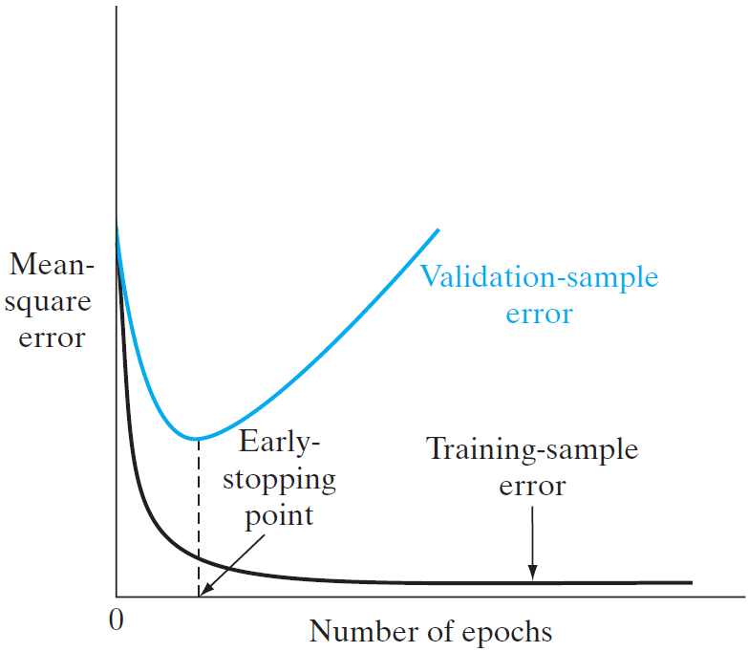
Early stopping procedure
How to perform learning with early stopping?
Divide the training data into estimation and validation subsets
Use a large number of hidden units
Use very small random initial values
Use a slow learning rate
Compute the validation error rate periodically during training
Stop training when the validation error rate starts increasing

Slide 37
Practical considerations of early stopping
One potential problem: validation error may go up and down numerous times during training → the safest approach is generally to train to convergence, saving the weights at each epoch, and then go back to weights at the epoch with the lowest validation error
Early stopping resembles regularization with weight decay which indicates that it will work best if the training starts with very small random initial weights
General practical problems
How to best split available training data into training and validation subsets?
What fraction of the patterns should be in the validation set?
Should the data be split randomly, or by some systematic algorithm?
→ Such issues are problem dependent
Notes:
Default MATLAB parameters (train, validation, test): 70%, 15%, 15%

Slide 38
Weight restriction and weight sharing
Perhaps the most obvious way to prevent overfitting in neural networks is to restrict the number of free parameters
The simplest solution is to restrict the number of hidden units, as this will automatically reduce the number of weights. The optimal number for a given problem can be determined by cross-validation.
An alternative solution is to have many weights in the network, but constrain certain groups of them to be equal
If there are symmetries in the problem, we can enforce hard weight sharing by building them into the network in advance
In other problems, we can use soft weight sharing where sets of weights are encouraged to have similar values by the learning algorithm → one way to implement soft weight sharing is to add an appropriate term to the error function → regularization

Slide 39
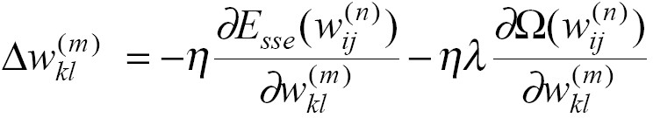
Regularization
Regularization technique encourages smoother network mappings by adding a penalty term to the standard (sum-squared-error) cost function
The regularization parameter λ controls the trade-off between reducing the error E_{sse} and increasing the smoothing
This modifies the gradient descent weight updates
The resulting neural network mapping is a compromise between fitting the data and minimizing the regularizer Ω

Slide 40
Regularization by weight decay
One of the simplest forms of regularizer is called weight decay and consists of the sum of squares of the network weights
In each epoch, the weights decay proportionally to their size
In conventional curve fitting, this regularizer is known as ridge regression
Empirically, this leads to significant improvements in generalization. Weight decay keeps the weights small and hence, the mappings are smooth.

Slide 41
Training with noise/ Jittering
Adding noise (jitter) to the inputs during training was also found empirically to improve network generalization
Noise will ‘smear out’ each data point and make it difficult for the network to fit the individual data points precisely, and consequently reduce overfitting
Jittering is accomplished by generating new inputs by using original inputs and small amounts of jitter. Adding jitter to the targets will not change the optimal weights, it will just slow down the training.
Jittering is also closely related to regularization methods such as weight decay and ridge regression

Slide 42
8.9 General guidelines
General guidelines for designing successful neural network solutions:
Understand and specify your problem
Acquire and analyze data, define inputs and outputs, remove outliers, apply preprocessing methods (rescale, standardize, normalize), extract and select features, properly encode outputs
Decide on network architecture (neural network type, neural network complexity, ...), start with simple neural network architectures – few layers, few neurons
Train the network and make sure it performs well on its training and validation data. If this doesn’t work, increase the complexity of the network or tune hyperparameters
Test its generalization by checking its performance on new (unseen) test data. If this doesn’t work, check your data, check the partitioning of data into train/test sets, and check and modify network architecture

Slide 43
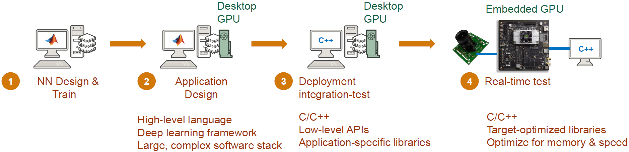
8.10 Deployment
NN deployment includes
NN design and training
Application design
Deployment integration-test
Real-time test
Notes:
Image: https://uk.mathworks.com/discovery/neural-network.html

Slide 44
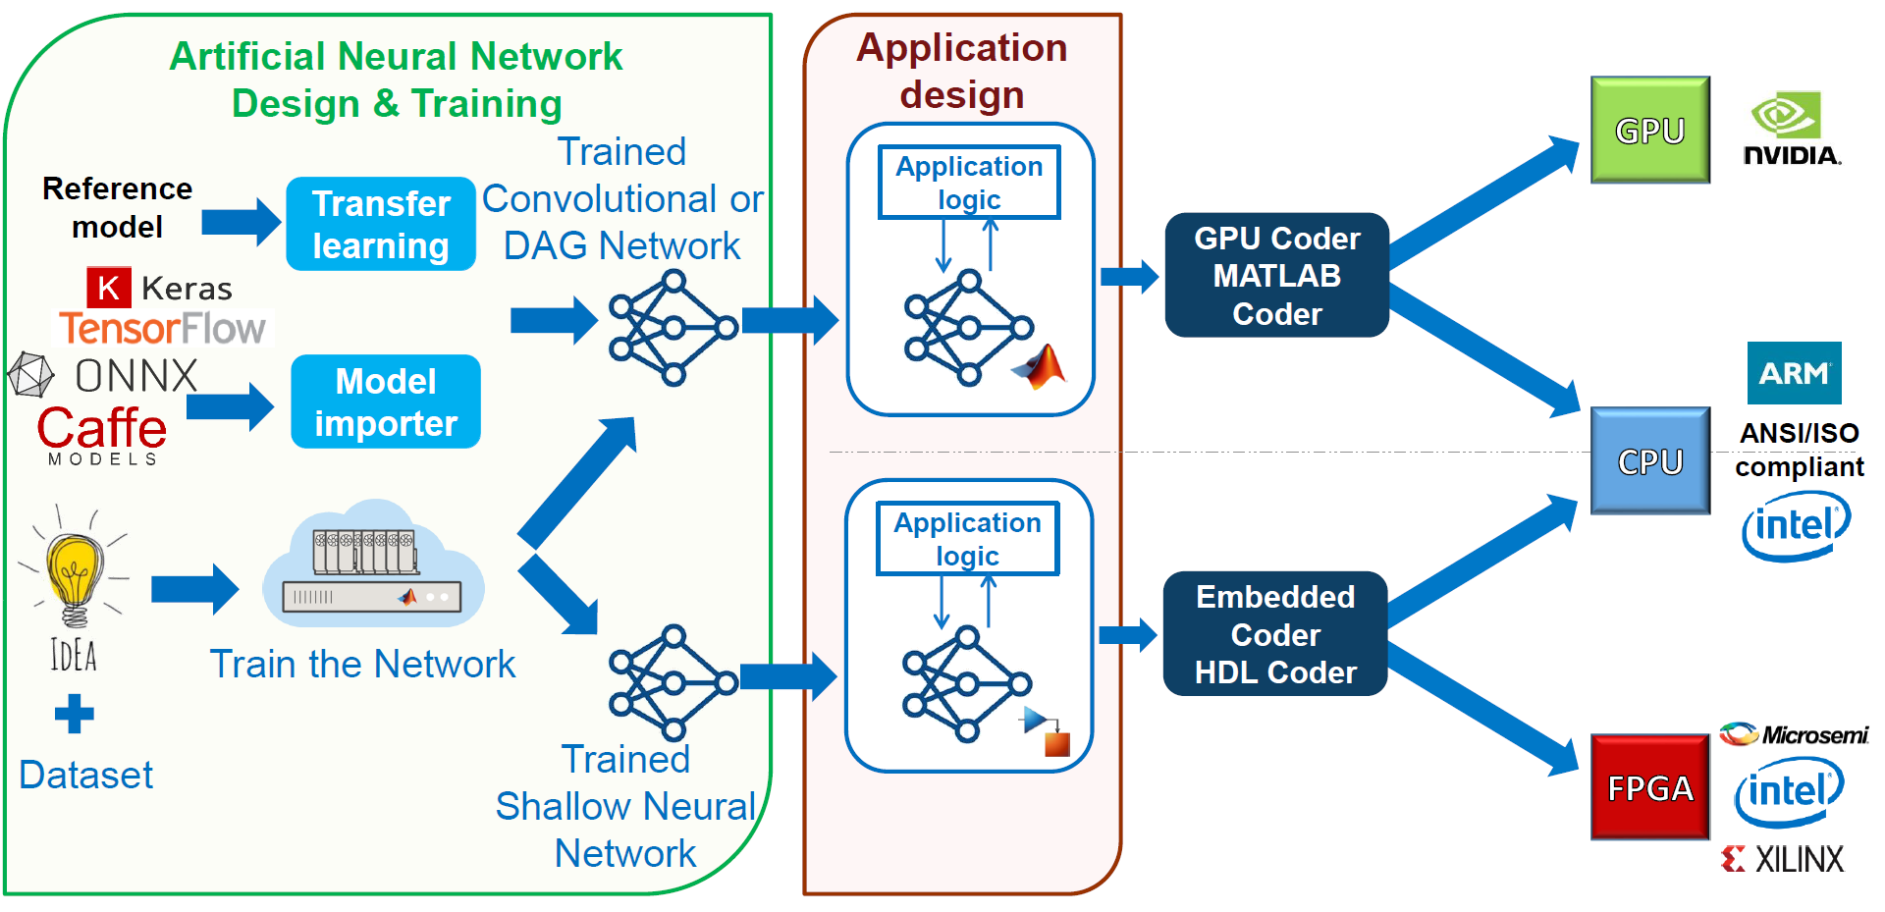
NN deployment in MATLAB
MATLAB workflow for deployment of NN to embedded targets

Slide 45
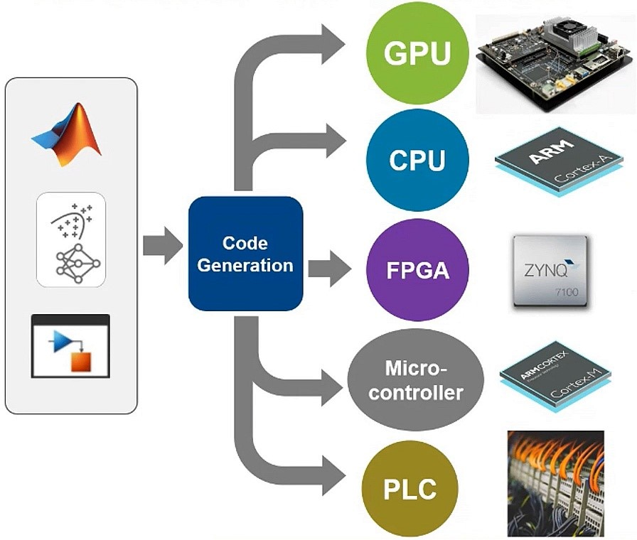
Code generation
Deployment of neural network solutions to various environments requires code generation
From development platform
To the chosen target platform
Target platforms
GPU
CPU
FPGA
Microcontrollers
Mobile phones
PLC
etc.
Notes:
Image: https://uk.mathworks.com/videos/fitting-ai-models-for-embedded-deployment-1653571688478.html

Slide 46

Integrate analytics with systems
Integrated analytics mean fusing your data insights solution into everyday workflows and applications, helping employees and customers make smarter decisions
Notes:
https://www.sisense.com/glossary/integrated-analytics/
https://www.mathworks.com/content/dam/mathworks/mathworks-dot-com/images/events/matlabexpo/us/2017/integrating-matlab-analytics-into-enterprise-applications.pdf

Slide 47
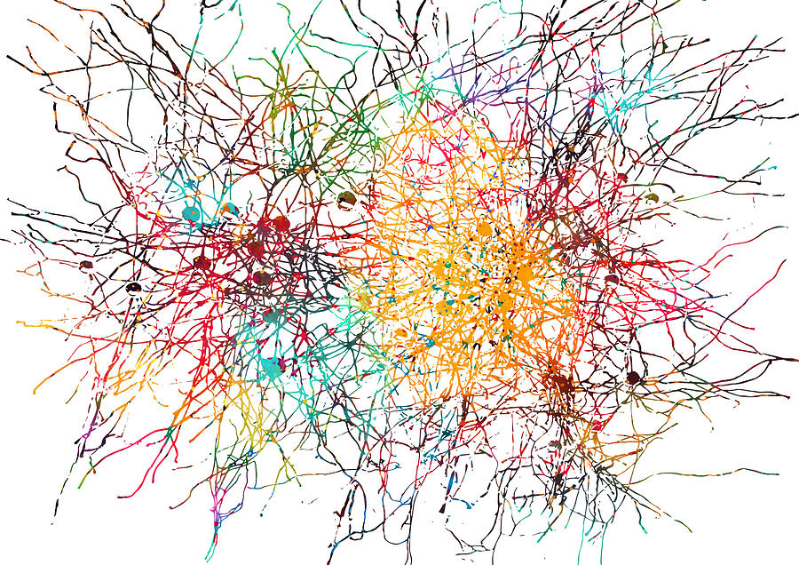
Thank you for participating
in the Curriculum module
Fundamentals of Neural Networks
Notes:
Image: https://pixels.com/featured/3-cortical-neurons-erzebet-s.html

